Slide 1
Introduction to TEA Algorithm

Slide 2
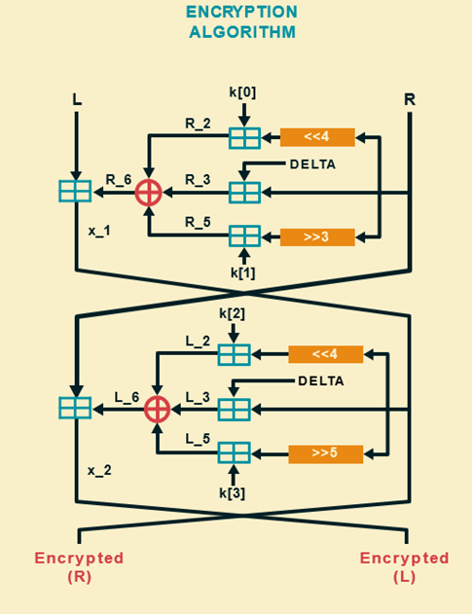
The Tiny Encryption Algorithm (TEA) designed by David Wheeler and Roger Needham in 1994.
Symmetric-key block cipher
64-bit blocks of data
128-bit key,
Feistel structure with 64 encryption rounds (32 Feistel Cycle)
Key Points: Simplicity, Efficiency, and Compactness
Vulnerabilities to certain attacks, such as related-key attacks and Equivalent Key
Leading to the development of improved versions like XTEA

Slide 3
Implementation of TEA

Slide 4
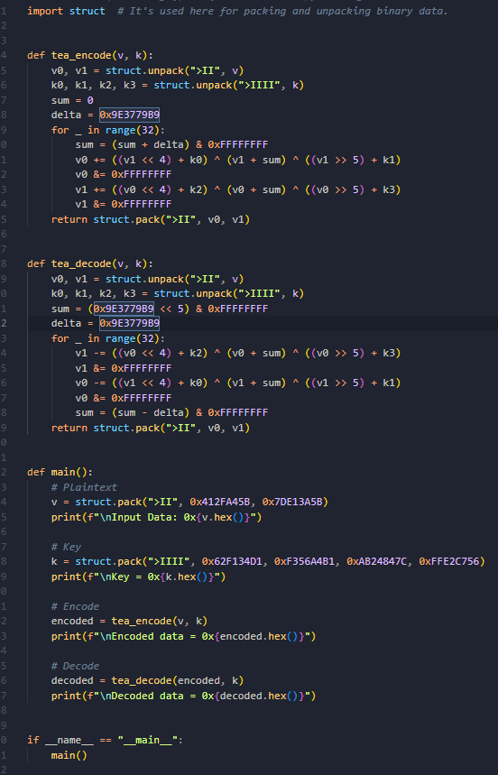

Slide 5
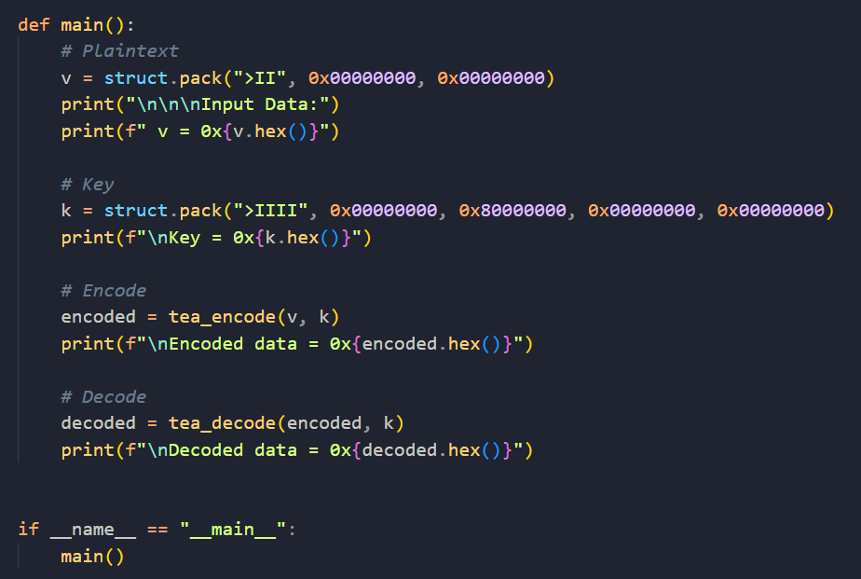
8 Bytes Data Block
16 Bytes Key
Notes:
Pack method is used as the algorithm requires precise bitwise operations to 32-bit unsigned integers.

Slide 6
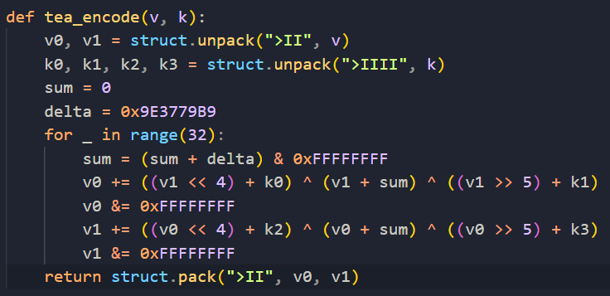
Encryption Algorithm
Constant = 0x9E3779B9
Delta Number / Golden Ratio
Notes:
Delta Number / Golden ratio:

Slide 7
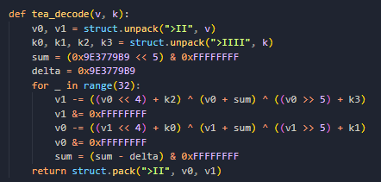
Decryption Algorithm

Slide 8
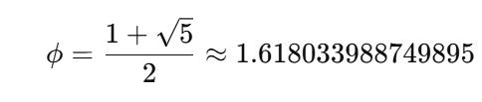


Golden Ratio/ Delta
Introduce non-linearity.
Ensure that the subkeys used in the rounds are highly unpredictable, even if the main key has some pattern.
Improves diffusion

Slide 9
Type of Attacks
01
02
Equivalent Key
Differential Related-Key Attack

Slide 10
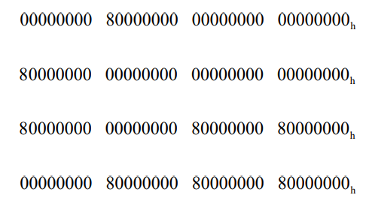
Equivalent Key
Four keys will produce the same cipher text
TEA unsuitable for use in a hash function

Slide 11
Findings
00000000h = 0
80000000h = 8
Input Data | Equivalent Key | Cipher Text
0x412fa45b7de13a5b | 0800 8000 8088 0888 | 0x36492fd1ea663875
0x412fa45b7de13a5b | 8888 0088 8800 0000 | 0x1182977124f0a216
0x412fa45b7de13a5b | 0008 0080 8808 8880 | 0x6764231f7c9d64ff
0x412fa45b7de13a5b | 0808 0880 8008 8080 | 0xd5724e217cbe74d9

Slide 12
Differential Related-Key Attack
Related Key Query:
Original Key
Flipping 30th bit (Second MSB) of K[2] and K[3]
Results:
The output of the even function remains the same is 50%
Yields 2-round iterative difference characteristic with probability equals to ½
60 Rounds (30 cycles) -> 2^(-30) probability
Literature Review:
Indicates 4R differential related key attack can break 64 round (32 cycle) TEA with one related key query and about 2^34 chosen plaintext

Slide 13
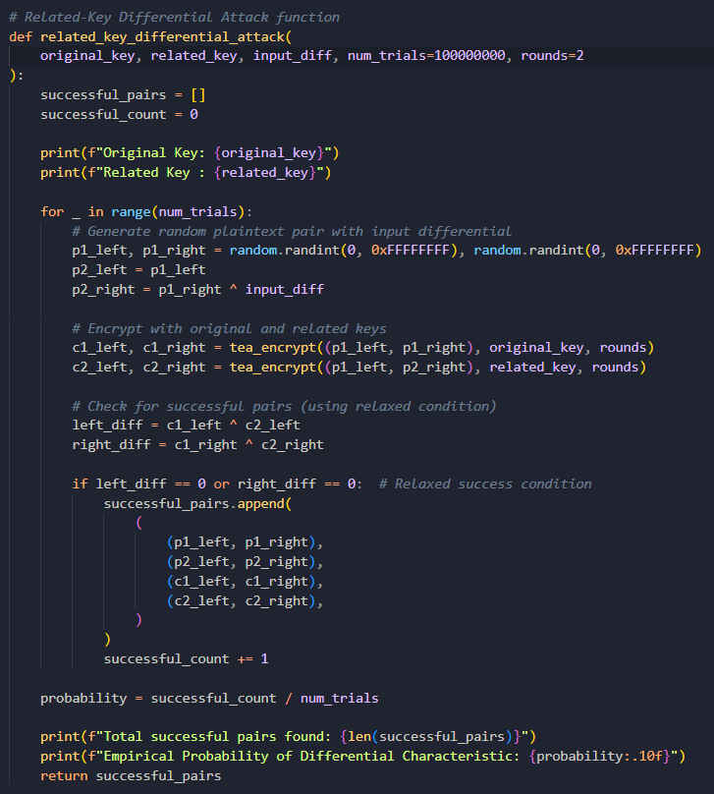
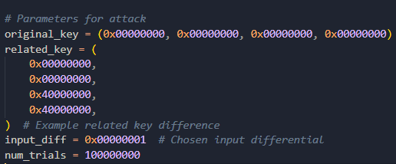
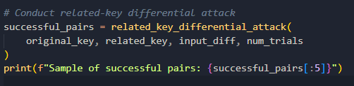
Set Up

Slide 14
Results

Slide 15
Test ID | Parameters (No. Of Trials) | Conditions | Pair Found | Probability | Time | Comment
1 | 10000 | Full String Match | 0 | 0 | 00:00:01 | Relax the condition
2 | 10000 | Half String Match | 0 | 0 | 00:00:01 | GPU Cluster
3 | 100000 | Half String Match | 0 | 0 | 00:00:04 | GPU Cluster
4 | 1000000 | Half String Match | 10 | 0.000012 | 00:00:05 | GPU Cluster
5 | 100000000 | Half String Match | 963 | 0.000009783 | 00:07:07 | GPU Cluster
6 | 10000000000 | Half String Match | No Result | NA | Limit | GPU Cluster
7 | 1000000000 | Half String Match | 9466 | 0.000009466 | 01:10:44 | GPU Cluster
8 | 2000000000 | Half String Match | 19157 | 0.000009578 | 02:25:34 | GPU Cluster
9 | 3000000000 | Half String Match | 28369 | 0.000009456 | 03:32:34 | GPU Cluster
10 | 4000000000 | Half String Match | 38275 | 0.000009568 | 04:42:27 | GPU Cluster

Slide 16
Test ID | Parameters (No. Of Trials + No. Of Rounds) | Pair Found | Probability | Time | Comment
1 | No. of Trials: 100000000 No. of Rounds: 4 | 0 | 0 | NA | GPU Cluster
2 | No. of Trials: 1000000000 No. of Rounds: 4 | 0 | 0 | NA | GPU Cluster
3 | No. of Trials: 2000000000 No. of Rounds: 4 | 0 | 0 | NA | GPU Cluster
4 | No. of Trials: 3000000000 No. of Rounds: 4 | 0 | 0 | NA | GPU Cluster
5 | No. of Trials: 4000000000 No. of Rounds: 4 | NA | NA | NA | GPU Cluster

Slide 17
Test ID | Parameters (Different Key + No. Of Rounds) | Pair Found | Probability | Time | Comment
1 | Original: 0x0000000F,0x0000000F,0x00000000,0x00000000 Related: 0x0000000F,0x0000000F,0x40000000,0x40000000, Rounds: 2 | 922 | 0.00000922 | NA | Host
2 | Original: 0x00000F0F,0x00000F0F,0x00000F00,0x00000F00 Related: 0x00000F0F,0x00000F0F,0x40000F00,0x40000F00, Rounds: 2 | 3185 | 0.00003185 | NA | Host
3 | Original: 0x00A00F0F,0x00000F0F,0x00A00F0F,0x00A00F0F Related: 0x00A00F0F,0x00000F0F,0x40A00F0F,0x40A00F0F Rounds: 2 | 5233 | 0.00005233 | NA | Host
4 | Original: 0x00A00FFF,0x00000FFF,0x00A00FFF,0x00A00FFF Related: 0x00A00FFF,0x00000FFF,0x40A00FFF,0x40A00FFF, Rounds: 2 | 683 | 0.00000683 | NA | Host
5 | Original: 0x00A90F0F,0x00090F0F,0x00A90F0F,0x00A90F0F Related: 0x00A90F0F,0x00090F0F,0x40A90F0F,0x40A90F0F, Rounds: 2 | 5181 | 0.00005181 | NA | Host

Slide 18
Test ID | Parameters (Different Key + No. Of Rounds) | Pair Found | Probability | Time | Comment
6 | Original: 0x00A90F0F,0x00090F0F, 0xC0A90F0F,0xC0A90F0F Related: 0x40A90F0F,0x40090F0F,0xC0A90F0F, 0xC0A90F0F, Rounds: 2 | 2616 | 0.00002616 | NA | Just trying other flip bit instead of k[2] & k[3] 30th bit
7 | Original: 0x40A90F0F,0x40090F0F,0xC0A90F0F,0xC0A90F0F Related: 0x40A90F0F,0x40090F0F,0xC0A90F0F,0xC0A90F0F, Rounds: 2 | 10391 | 0.00010391 | NA | No related key, should have no pair found?
8 | Original: 0x40A90F0F,0x40090F0F,0xC0A90F0F,0xC0A90F0F Related: 0x40A90F0F,0x40090F0F,0xC0A90F0F,0xC0A90F0F, Rounds: 4 | 1 | 0.00000001 | NA | Trying 4 rounds [((2941974260, 754361866), (2941974260, 754361867), (1151858865, 3443377405), (1151858865, 3443377118))]
9 | Original: 0x40A90F0F,0x40090F0F,0xC0A90F0F,0xC0A90F0F Related: 0x40A90F0F,0x40090F0F,0xC0A90F0F,0xC0A90F0F, Rounds: 2 | 5130 | 0.0000513 | NA | Host

Slide 19
Test ID | Parameters (No. Of Trials + Input diff) | Pair Found | Probability
1 | Input Diff: 0x00000000 No of trials: 1000000 | 499917 | 0.4999170000
2 | Input Diff: 0x00000001 No of trials: 1000000 | 4 | 0.0000040000
3 | Input Diff: 0x00010000 No of trials: 1000000 | 0 | 0.0000000000
4 | Input Diff: 0x00010000 No of trials: 10000000 | 0 | 0.0000000000
5 | Input Diff: 0x00000010 No of trials: 1000000 | 0 | 0.0000000000
6 | Input Diff: 0x00000100 No of trials: 1000000 | 4 | 0.0000040000
7 | Input Diff: 0x00001000 No of trials: 1000000 | 0 | 0.0000000000
8 | Input Diff: 0x00100000 No of trials: 1000000 | 0 | 0.0000000000
9 | Input Diff: 0x01000000 No of trials: 1000000 | 0 | 0.0000000000
10 | Input Diff: 0x10000000 No of trials: 1000000 | 0 | 0.0000000000

Slide 20
WHY IS TEA VULNERABLE?
KEY Scheduling
XTEA
Splitting the key into four parts
Improved Version
Notes:
The success of this attack is due to:
The small size of R4 (17 bits) makes brute-force guessing feasible.
The linear nature of the cipher allows for the construction of solvable equation systems.
The key setup process can be reversed once the initial state is known. These vulnerabilities led to A5/2 being quickly deprecated in favor of stronger algorithms.

